Slide 1

Table of Contents
Objective
Overview of the Project
Workflow
Process Automation
Result

Slide 2

Objective
Recommended System:
Our aim is to predict the items (Celebrities, topics, etc.,) and recommend to the Fankick Users.
Use Cases:
Identifying top celebrities based on below parameters to select his/her favorite celebrity​
User Attributes(ex : location, gender, categories liked)​
User interactions in past (Clubs which are subscribed to, Contests participated)

Slide 3

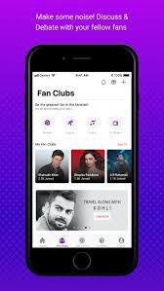


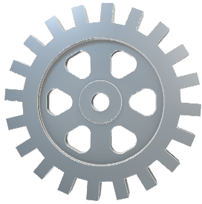


Overview of the Project
Stores the User Interactions
Extract Data
Train the model
Deploy API
Model Creation using Recommended Algorithms
Azure ML
Python
API
Recommendation to user using API
Interaction with the App

Slide 4
workflow
Extract Datasets
Datasets to train the model
Azure Storage
Final Datasets
5
2
Model Creation
MongoDB
3
Connectivity
Data Extraction
Data Preprocessing
1
4
Acquiring required Datasets
Ex: Interest Score calculation between user & celebrity
Ex: Gender Prediction
Collaborative
Filtering
Content-based Filtering
User Details
User History
Celebrity Details
Algorithm: SAR
Algorithm: LGBM
Note: This data can be used for Power BI or any other reporting tool
6
Deploy API
Azure ML Workspace

Slide 5
Process Automation
Azure ML Studio
Model Version Management
Dataset Version Management
Azure ML Ops
This pipeline Captures Data changes in the source
Data is stored in Azure Cloud which can be used by any ML model or Reporting tools.
Delta Capture
Data Extraction
Data Preprocessing
Azure Storage
Model Continuous Integration & Deployment(Prod)
This pipeline automates the recursive learning process to incorporate updated behavior of the user
This takes care of production deployment
Azure Storage
Model Training
Deploy API

